Slide 1


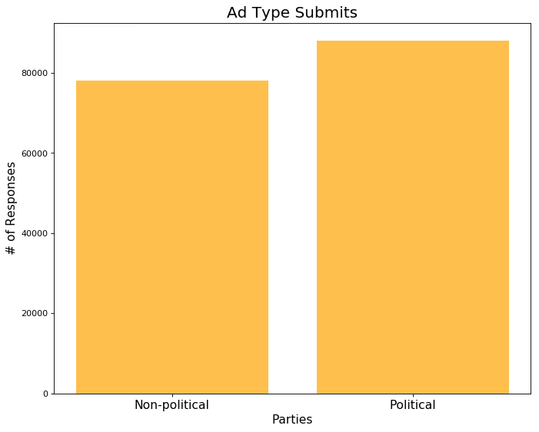
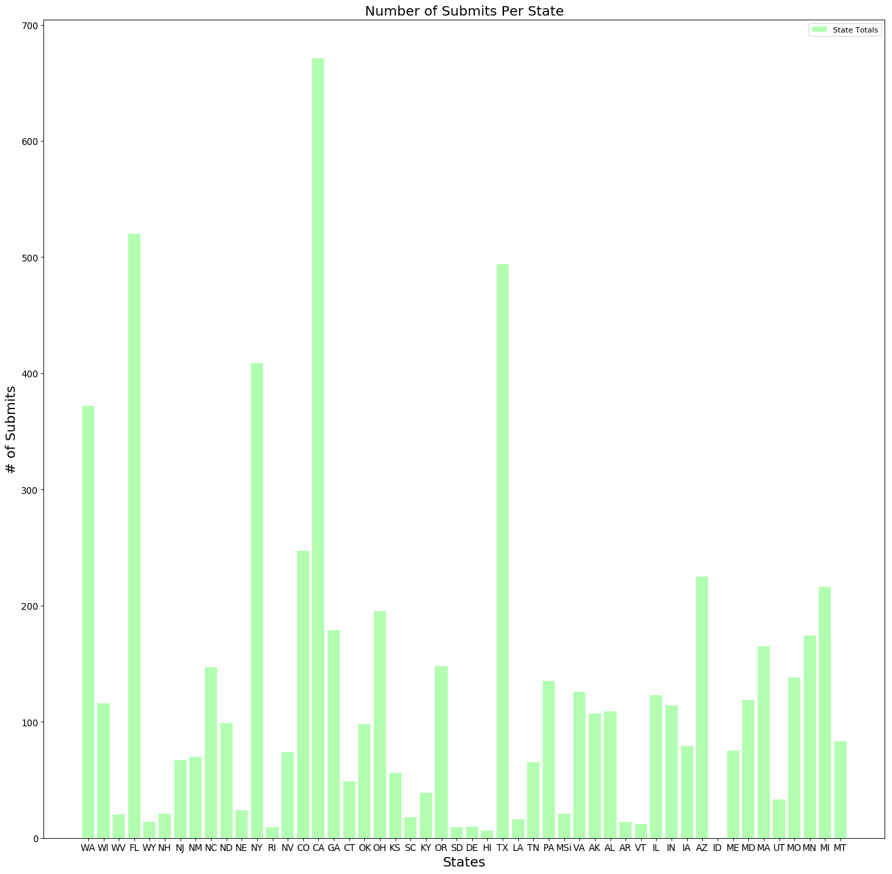
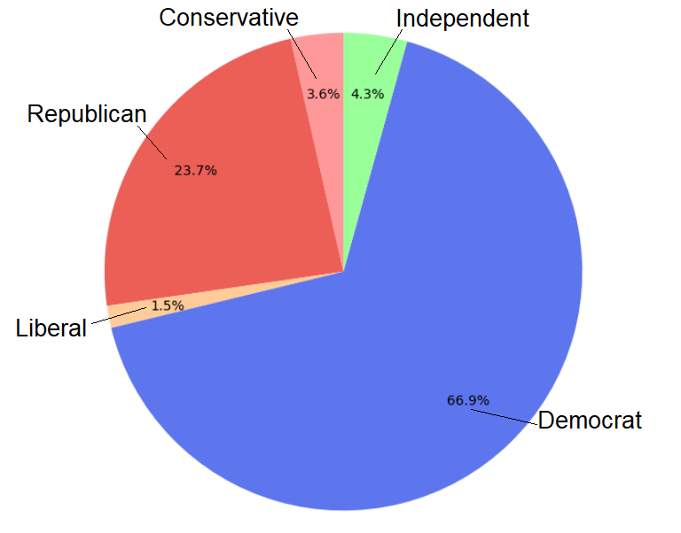

Facebook Political Advertisements
Sarah Higgins John Sanders
Dr. Salem Othman
Wentworth Institute of Technology
Abstract
Methods/Materials
Results
Conclusions
Utilizes a database comprised of almost 200,000 Facebook political advertisements gathered by users of the site through a browser extension.
Determines which ads have been deemed “Political” and whether or not they accurately target the correct intended demographic.
Determines which parties have created the most ads on Facebook, trying to further their influence to the public through social media?
ProPublica Data Store: This database, updated daily, contains ads that ran on Facebook and were submitted by thousands of ProPublica users from around the world. Users were asked to install browser extensions that automatically collected advertisements on their Facebook pages and sent them to ProPublica servers. A machine learning classifier is then used to identify which ads were likely political and then included them in the dataset.
Apache Spark: Spark is the main driver of the project, and executes the SQL queries that are done to the data. Spark manages all the actions and transformations that are done to the data, and will display our results.
Google Cloud Platform: Google Cloud hosts the Kubernetes clusters used to manage the very large dataset, which could not be run on a local machine due to its size.
.
Results:
More than half of the ads on Facebook have been deemed political
Many ads being contributed to heavily Democratic states like California and heavily Republican states like Texas
Many ads being contributed to key-swing states like Florida, Arizona
More Democratic-leaning ads being seen than Republican-leaning ads
Conclusion:
We have found that organizations are publishing advertisements more than ever. Most of these ads are being contributed to key-political states, such as CA, TX & FL. Due to the aftermath of the 2016 election, the Democratic party seems to be creating the most advertisements to filter out the noise and provide users with the correct information for future elections.
Figure 3: Political/Non-Political Ads
Introduction
Figure 2: Ads Per State
Social Media services, such as Facebook, have become a platform for political media to be shared, and has become extremely relevant to how many American citizens form their political opinions. Political organizations have seen the potential audience that is possible to reach, and have begun using the platform to advertise political ideologies to Facebook’s users. But what if these ads were used maliciously by organizations hoping to dissuade the American Public? This project uses a large dataset of Facebook political ads collected daily from Facebook users. Apache Spark is then used to do SQL queries on the database to determine what ads in the dataset are political, which political parties are publishing the most advertisements, and which regions of the country these ads most being created in. These Spark SQL queries are done on a Google Cloud Kubernetes Cluster, which can handle running the large dataset, unlike local machines.
References
ProPublica. “Political Advertisements from Facebook.” ProPublica Data Store, Jun. 2019
Propublica. “Propublica/Facebook-Political-Ads.” GitHub, Jun. 2019
Larson, Jeff, et al. “How We Are Monitoring Political Ads on Facebook.” ProPublica, Jun. 2019
Figure 1: Ads Per Political Party

